Slide 1

Measuring the risk build up in Armenian financial system: A Growth-at-Risk approach
Vladimir Yeghiazaryan, Arthur Grigoryan
Central Bank of Armenia
Important disclaimer: The views expressed in this paper are those of authors, and do not necessarily represent the views of the Central Bank of Armenia

Slide 2
What is it about?
Recent years have seen a rapid operationalization of Macroprudential policy (MP) in many countries. But it still lacks reliable quantitative measurement framework and a criteria for policy rule (as in case of Monetary Policy).
The main problems of MP are that:
Wide diversity of tools with overlapping coverage
The impact is difficult to quantify
Strong non-linearities in the effects of MP
The absence of a clear and well-defined target

Slide 3
What is Growth-at-Risk?
In simple terms, Growth-at-Risk framework is used to model the impact of exogenous variables not on the mean value of dependent variable, but on its entire distribution.
To do this, it uses quantile regression approach (Koenker & Basett, 1978).
The benefits of GaR framework:
Measure short-term costs vs long-term benefits of Macroprudential policy tools,
The mean/median of distribution as indicator for potential benefits.
And the tail (usually 5th or 10th quantile) as a measure of risks
Perform policy simulations,
Design an intuitive policy decision rule

Slide 4
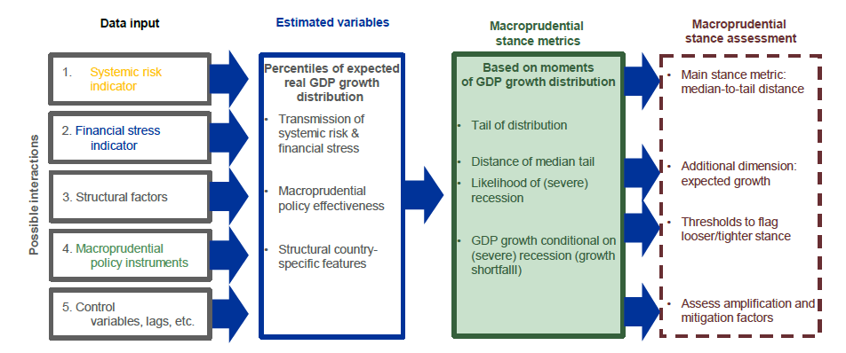
Growth-at-Risk Framework
Data sources:
IMF (FSI and IFS)
World Bank
BIS
TradingView (for Gov bond data)
OECD (house prices)
CBA
Source: ESRB

Slide 5
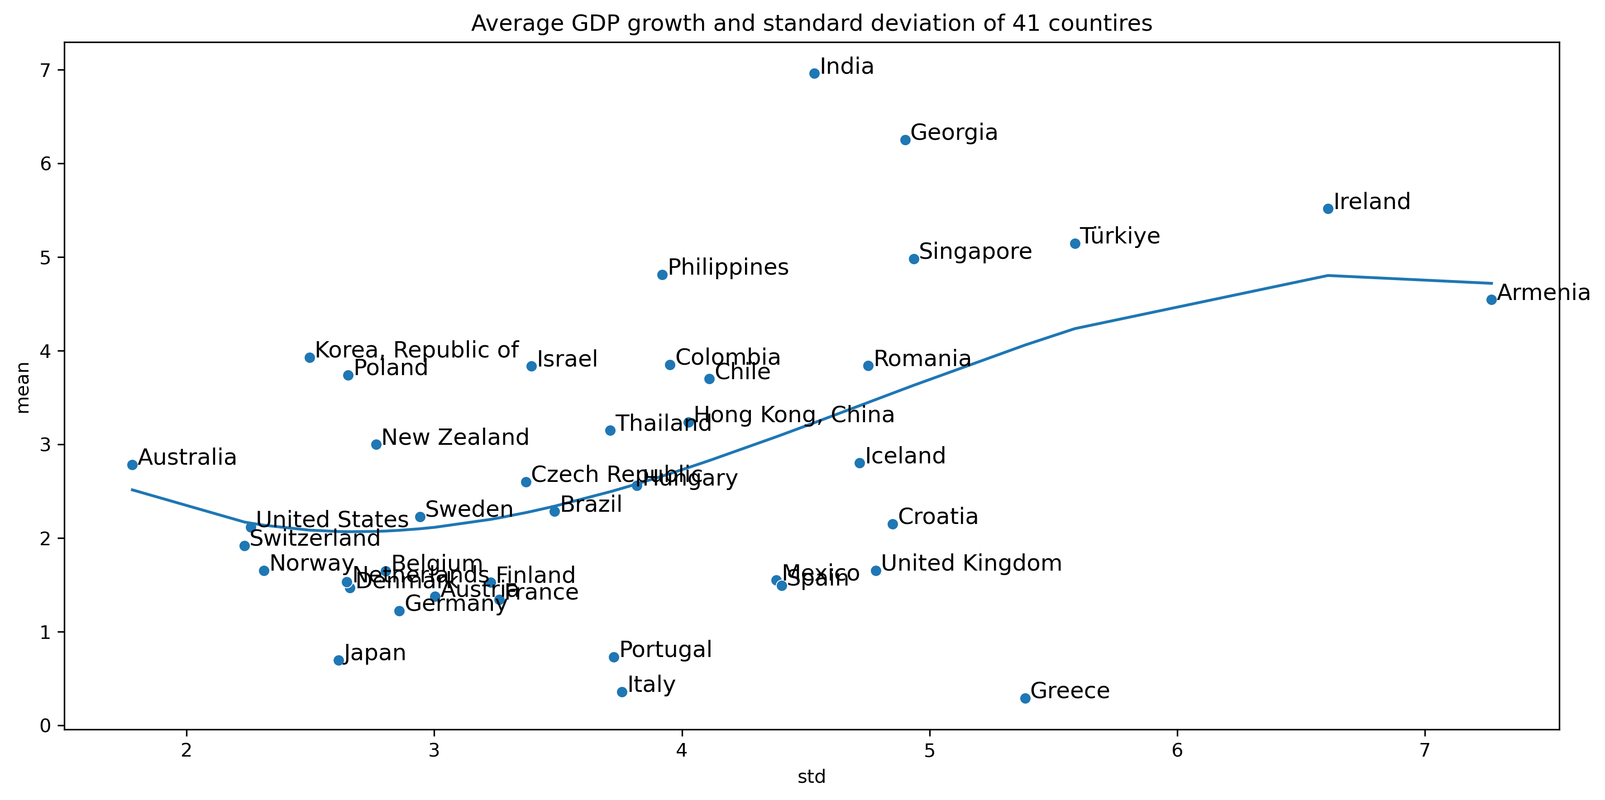
How to grow? Boom-busts vs steady growth paths
Going over the risk-reward relationship, we observe diminishing returns for countries with boom-bust growth fundamentals.

Slide 6
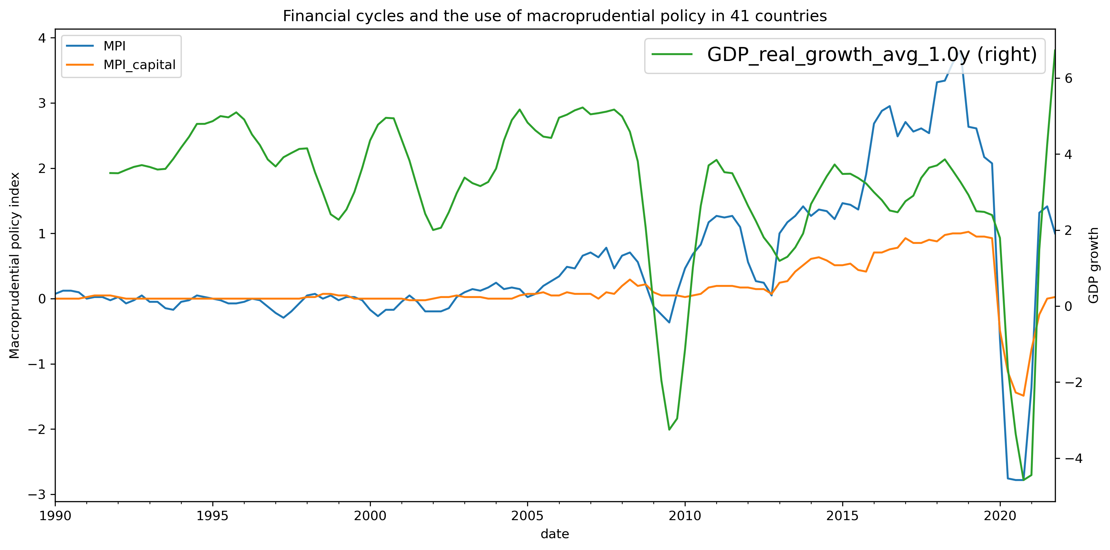
Use of Macroprudential policy
Over time MP used different tools. Capital-based tools were extensively used during COVID shock in 2020-2021.

Slide 7
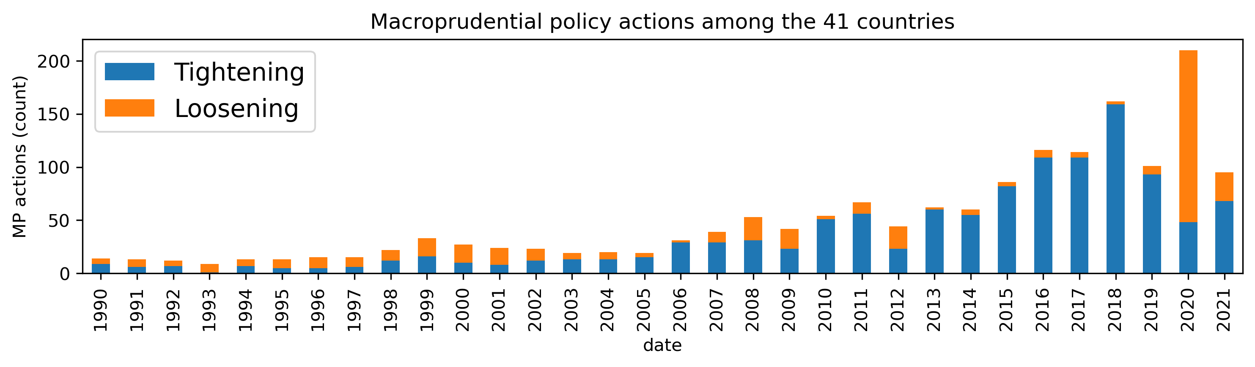
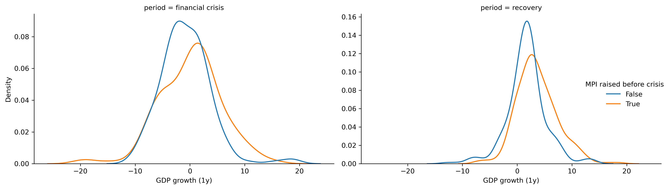
Use of Macroprudential policy
Over time the policymakers increased the usage of MP tools. Mainly it has been restrictive, except for crisis periods (2008, 2020 etc.)

Slide 8
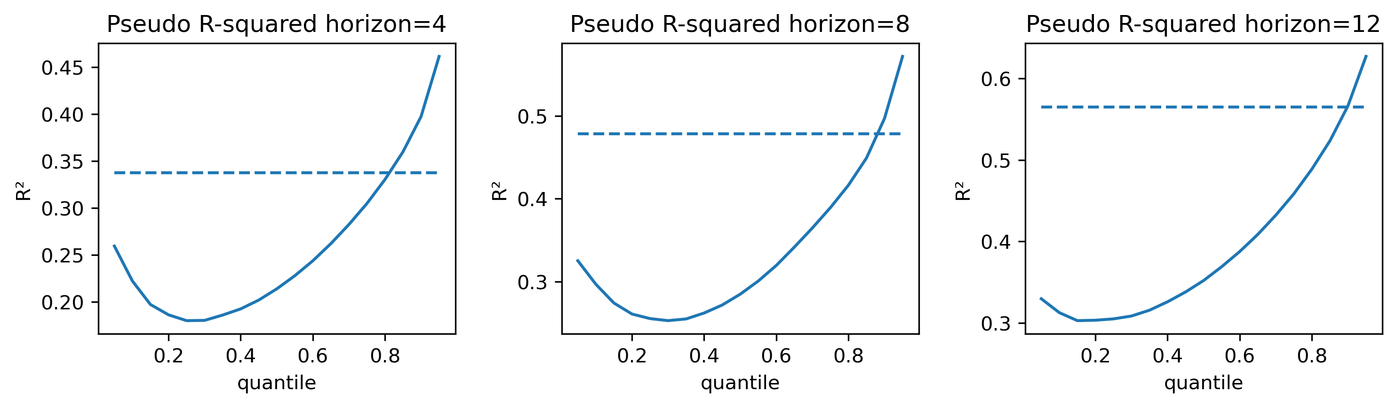
Panel model
The main benefit of quantile regression is that it allows us to model the non-linear relationships, that can affect the GDP distribution.
The pseudo R2 for our model is around

Slide 9
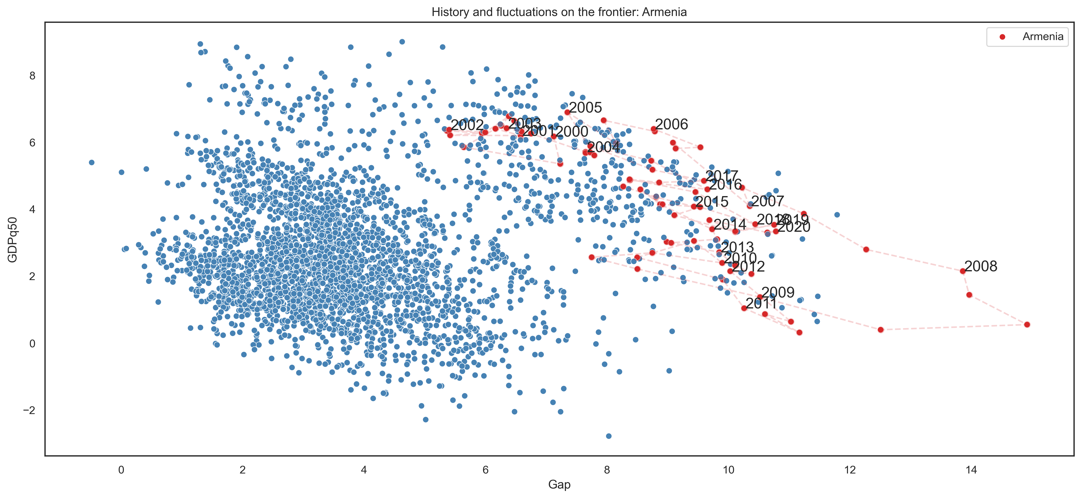
Armenia risk-return vs world
According to panel estimations, Armenia’s growth pattern is generally in boom-bust territory.

Slide 10
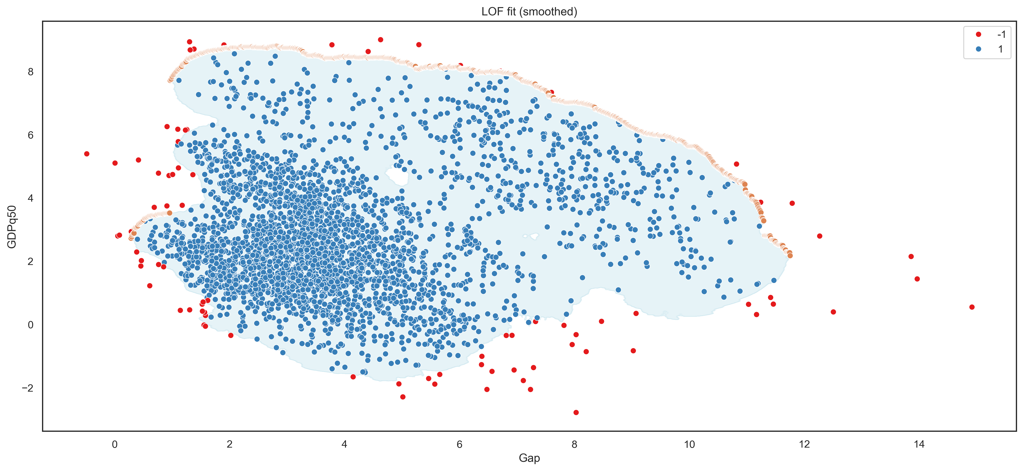
Frontier for best risk-return cases
Using LOF method, we estimate the frontier for the best risk-return performing countries

Slide 11
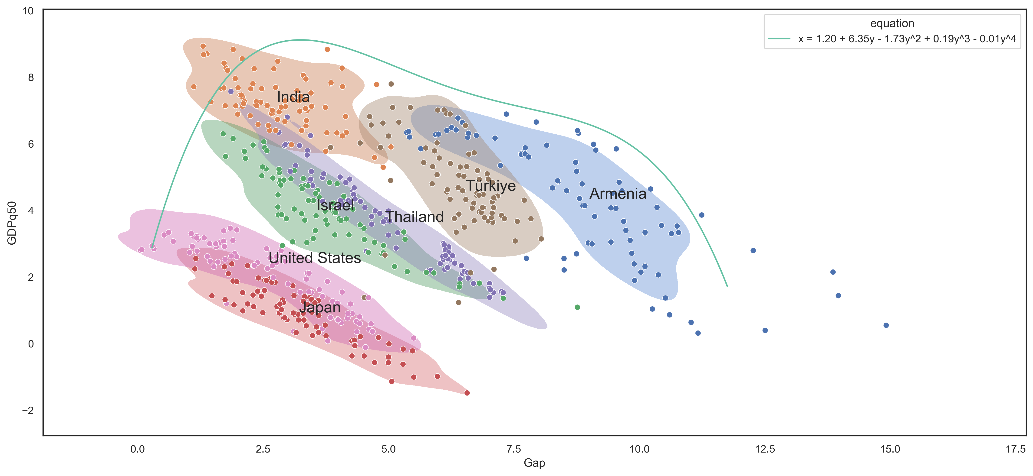
Country cases that shape the boundary
According to the estimations, beyond the 4-5% GDP shortfall, additional risk-taking is suboptimal. Countries should aim to manage their risks so that it is less than this threshold.

Slide 12
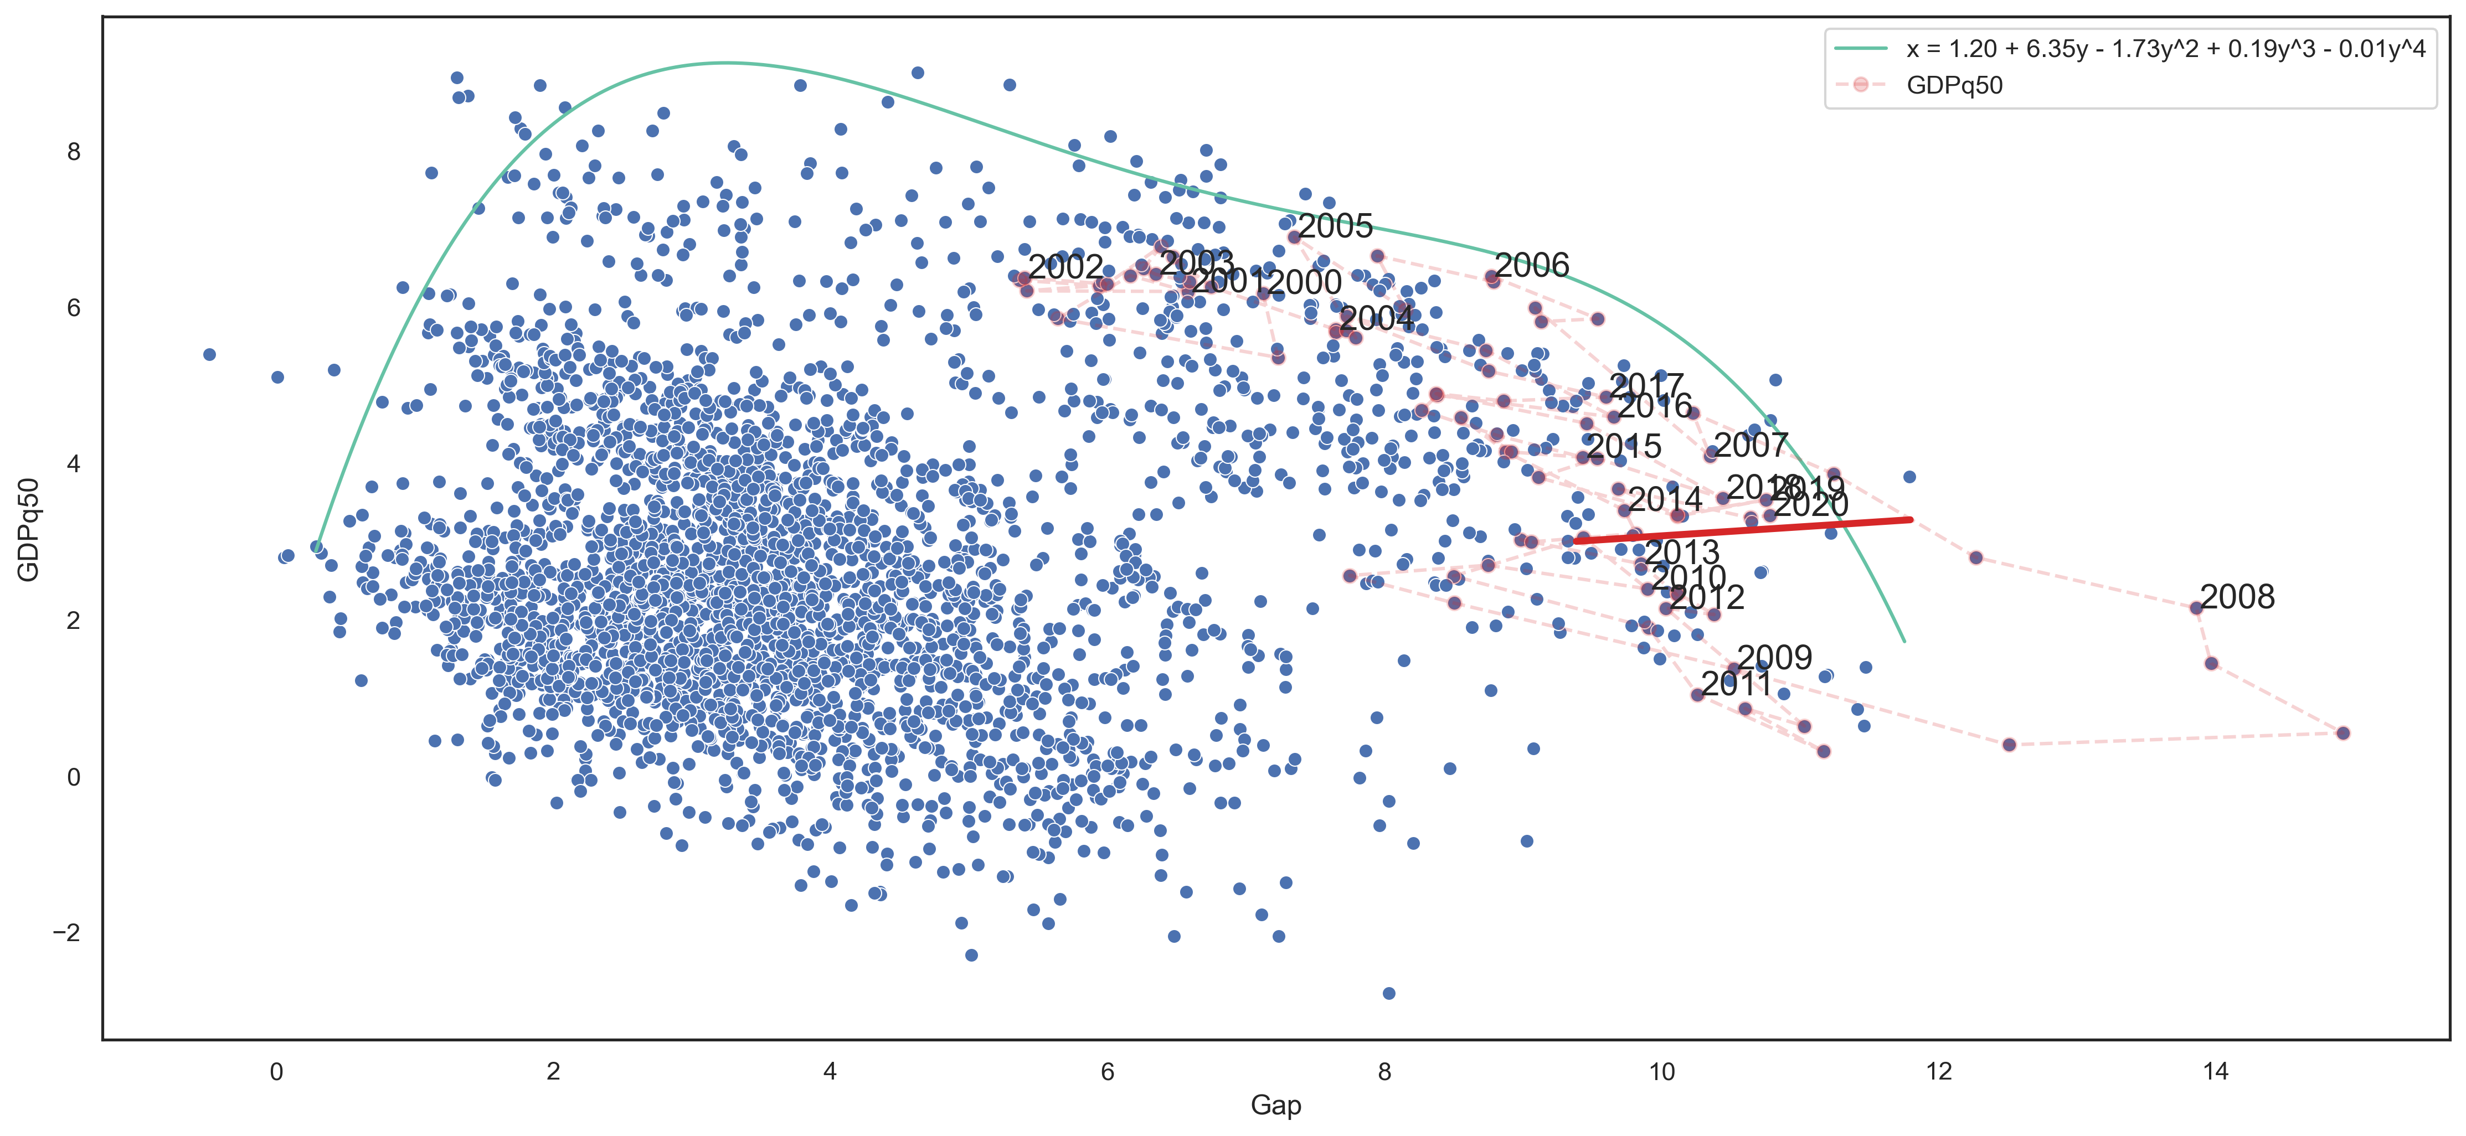
Possibility curve and the frontier
The possibility curve is bundle of the risk-return values that are achievable through the tightening and loosening of MP

Slide 13
Risk absorption capacity remains high
Capital adequacy
RoE and leverage

Slide 14
Real estate prices have grown. There are possible overvaluation risks
The growth rate of average real estate price*
The estimated size of deviation of real estate prices from their fundamental levels **
During last 5 years real estate prices have risen by almost 50%
* For 1 sq. meter of multi-flat apartment building in Yerevan
Source` Real estate cadastre RA, CB calculations
**It is worth to mention, that this estimate is only a warning sign for possible overvaluation risks in real estate market and should not be interpreted as a forecast of real estate prices

Slide 15
Growth-at-Risk Framework
Data sources:
IMF (FSI and IFS)
World Bank
BIS
TradingView (for Gov bond data)
OECD (house prices)
CBA
Source: ESRB

Slide 16
Key indicators
Financial vulnerability – captures cyclical system risk arising from credit and external imbalances. It has good early warning properties (Lang et al., 2019).
Financial stress – periods in which risks have materialized, reflected in stress episodes with larger asset price volatility, interest rate spreads, and deteriorated risk sentiment. Incorporates variables from financial markets, including interest rates with different maturities (Koop and Korobilis, 2014).
Macroprudential policy index – a dummy variable, where a value of – 1 indicates loosening, +1 tightening and no actions are defined as 0. To account for the persistence in MP tools, a 4 quarter rolling sum is used (Galan, 2020).
Structural variables – includes a range of variables from financial sector, such as indicators for risk absorption capacity (capital, liquidity, profitability ratios), as well as risk-related variables (NPL ratio etc.).
Control variables – variables from macroeconomy

Slide 17
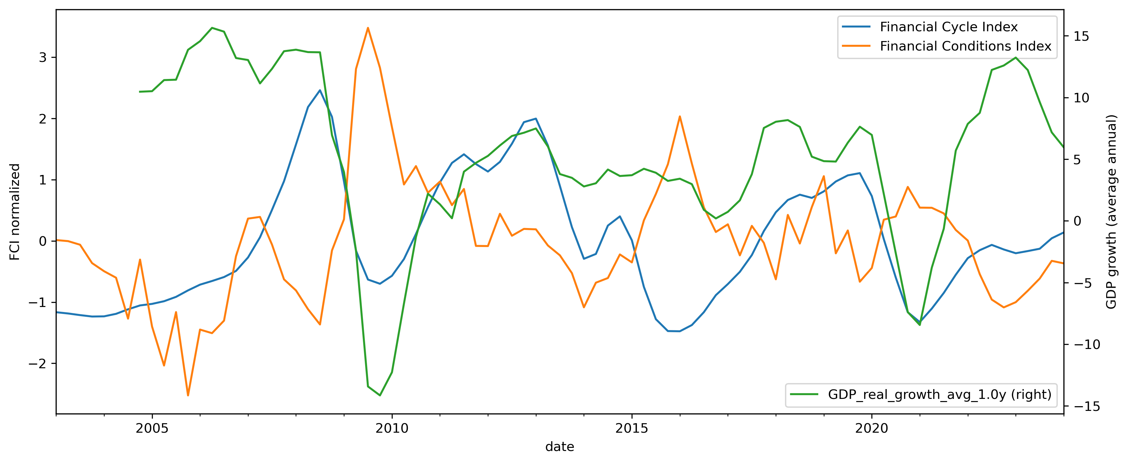
Financial vulnerabilities, stress and real GDP growth
The Financial cycle index tracks the risk build-ups in our financial system and is used as a forward looking indicator. The Financial conditions index is meant to show the current tension level in the financial markets.

Slide 18
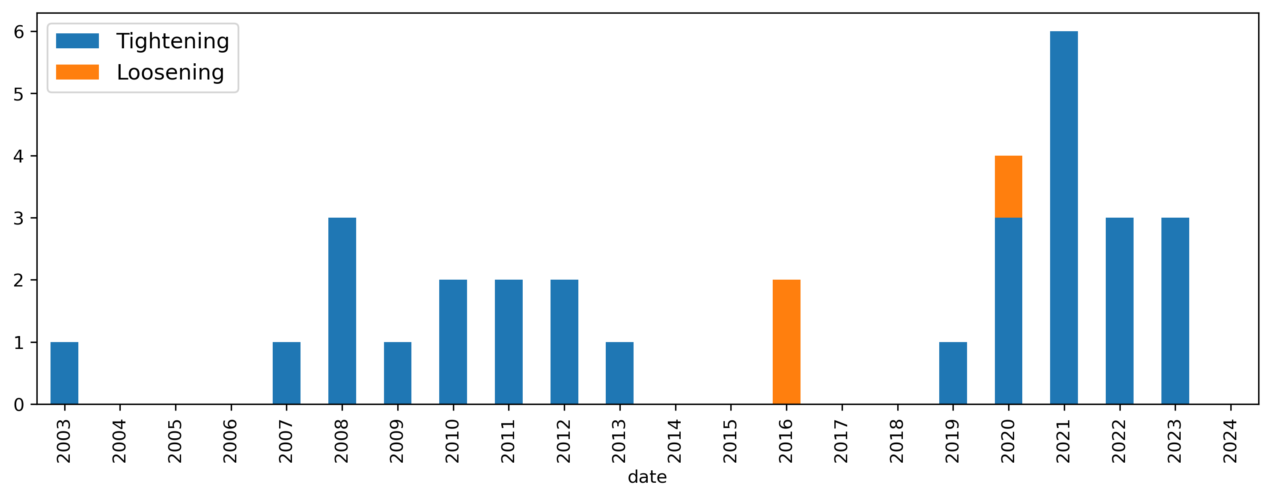
Macroprudential policy usage in Armenia
The MP has been increasingly used after the Great Recession of 2008, as a result the MP history in Armenia is short. To improve the robustness of the results, we generalize the MP coefficient using the panel estimates.

Slide 19
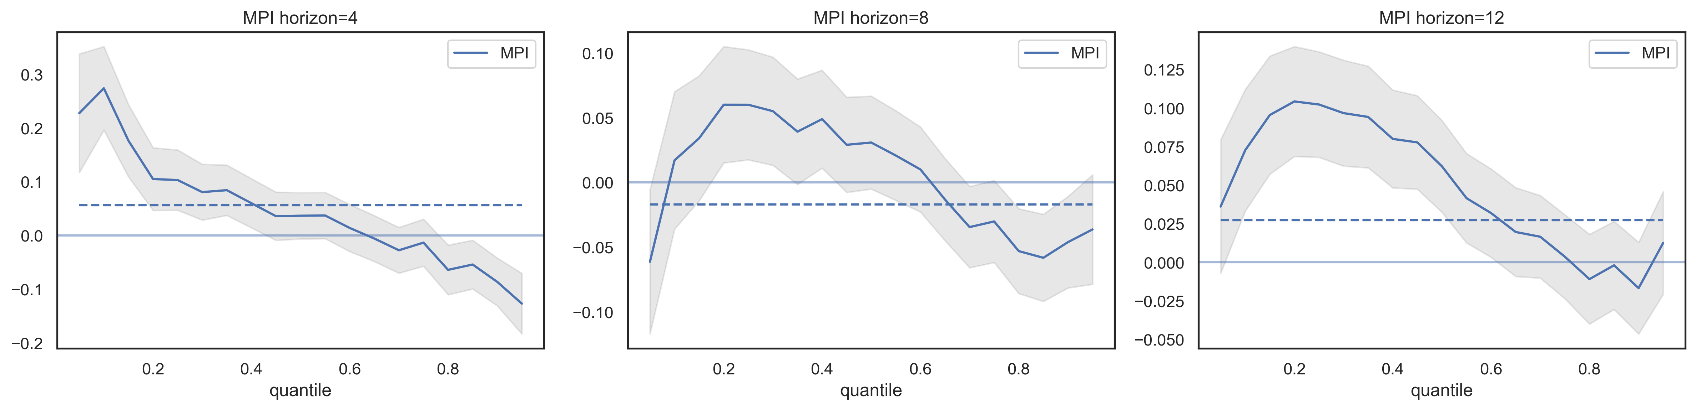
Panel estimation results: The effect of MPI
In the short-run the tightening of MP mitigates the systemic risks (the left tail shrinkage), and has an insignificant impact on the median. A similar pattern can be observed for the long run effects.

Slide 20
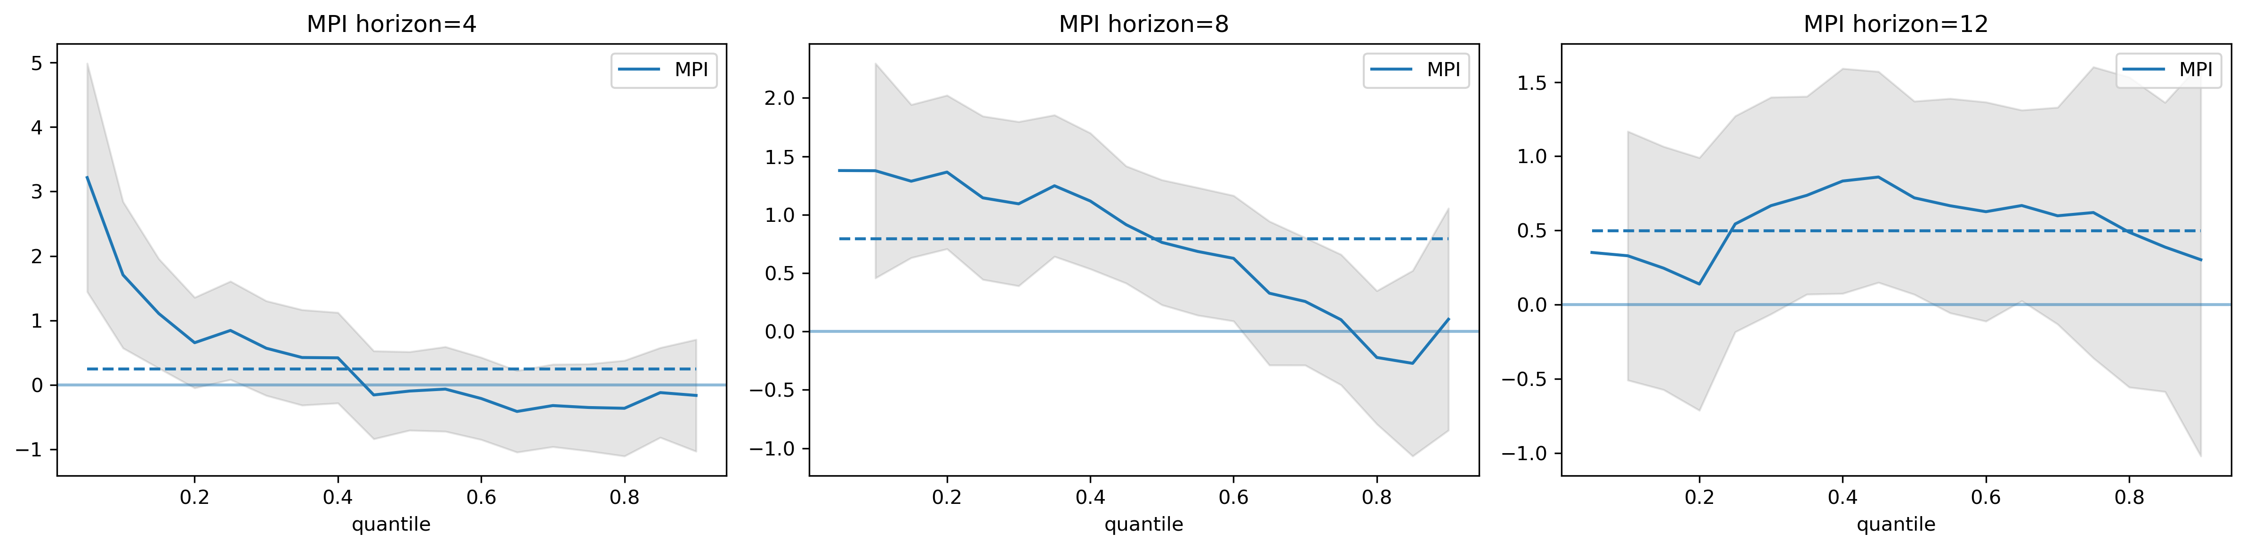
Local estimation results: The effect of MPI
The short-run local model results are in line with panel estimates. The coefficients for the long-run model indicate positive effects across the entire distribution.

Slide 21
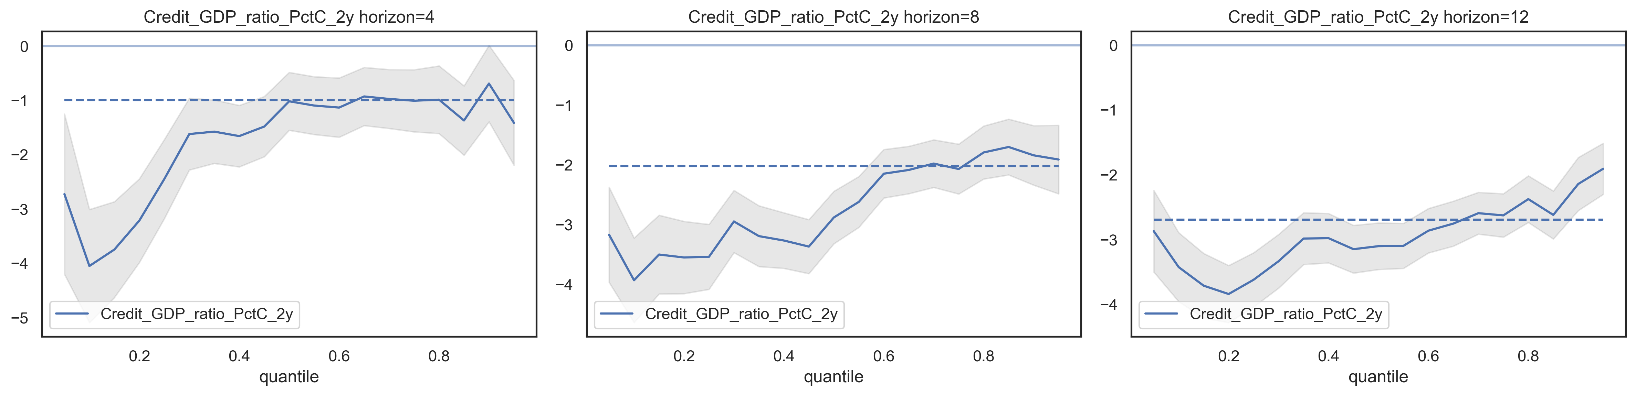
Panel estimation results: the effect of financial vulnerabilities
A positive shock to financial intermediation (excessive credit growth) causes the risks to rise in both short- and long-term, to simultaneously deteriorate the average GDP growth prospects in the long-run.

Slide 22
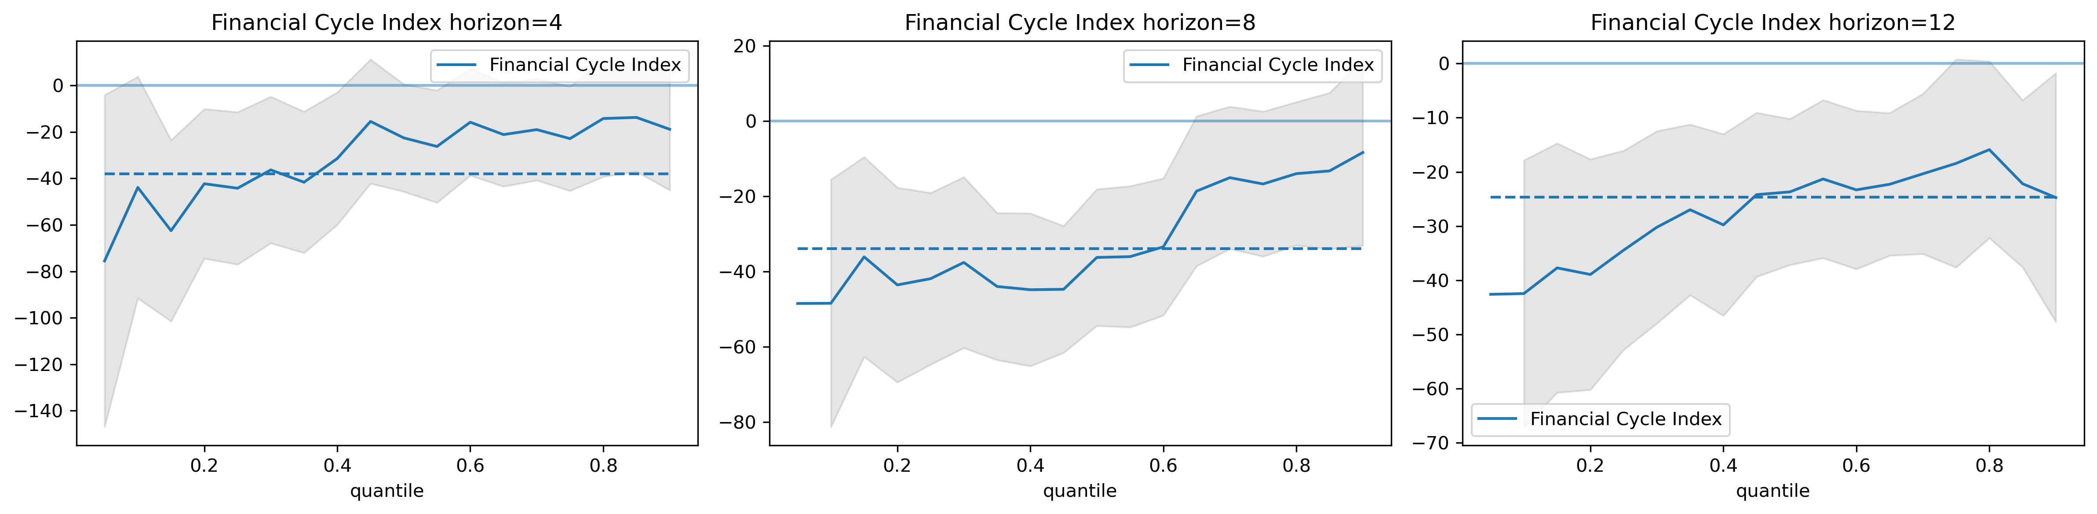
Local estimation results: the effect of financial vulnerabilities
The deteriorate the average GDP growth as a result of excessive credit growth continues to persist in the long-run.

Slide 23
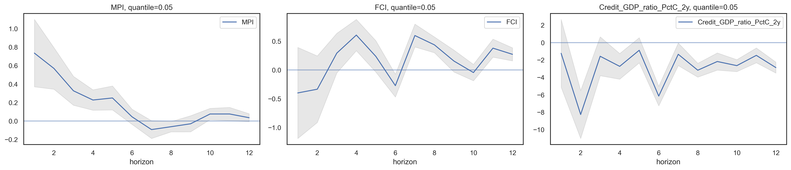
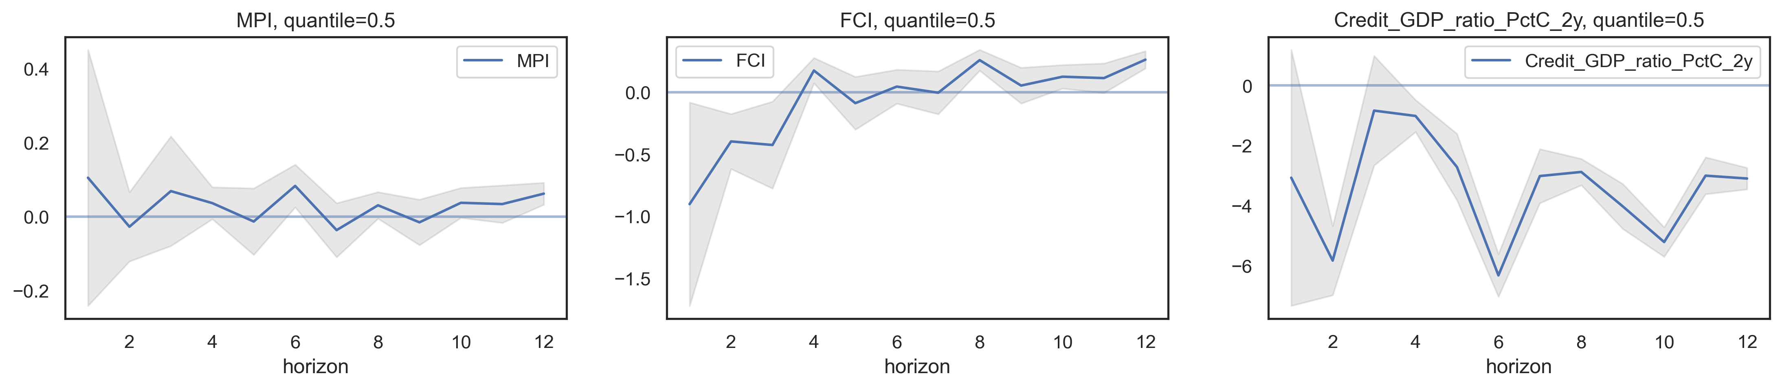
Panel estimation results: effects by horizons
The usage of MP heavily affects the risky tail of GDP growth distribution within 1.5 years, while having virtually no impact on average GDP growth.

Slide 24
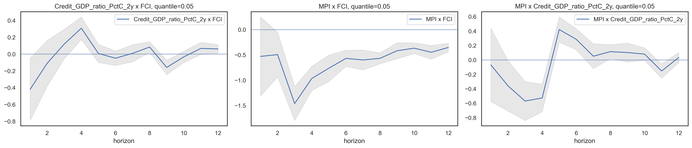
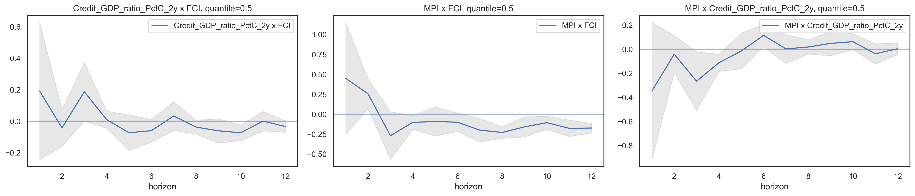
Panel estimation results: interaction effects
According to the estimates the loosening of MP when the financial conditions are tight (stress is high), will have a positive effect on the tail reducing the risks up to 0.5% in the long-run.

Slide 25
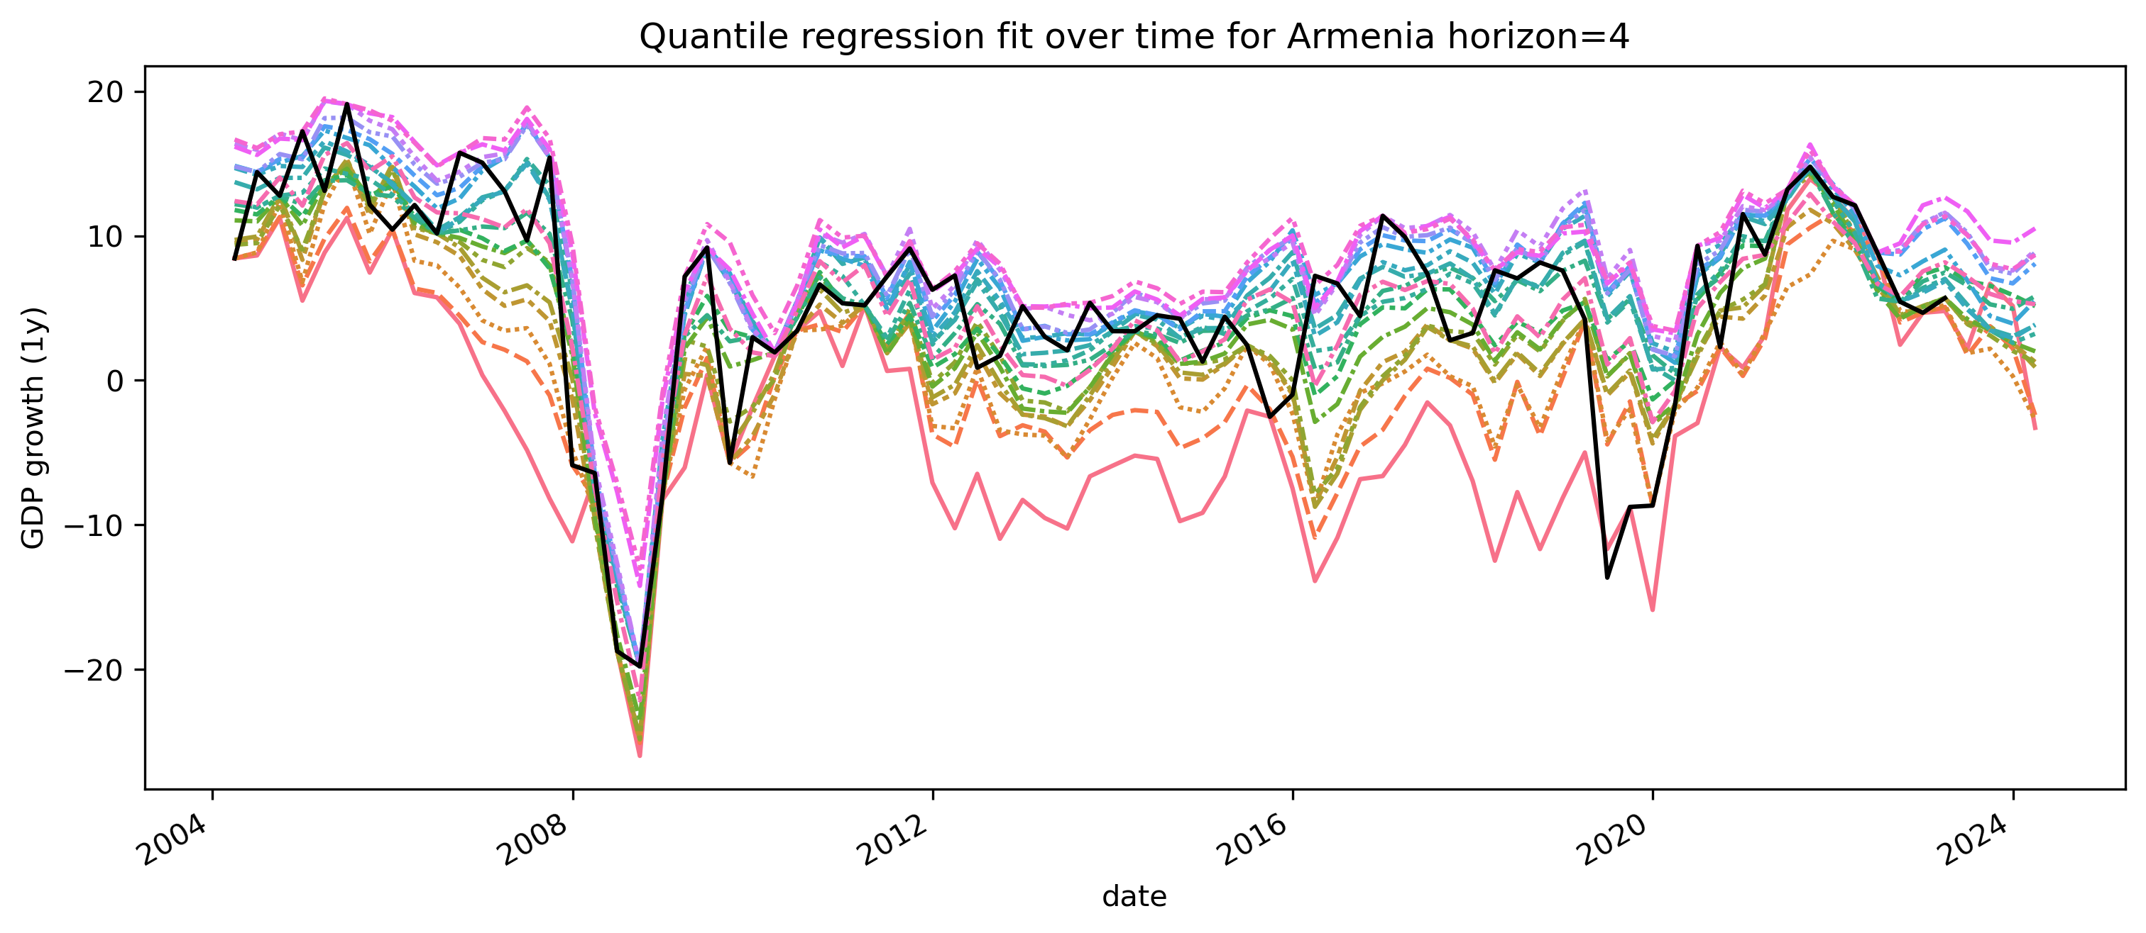
Historical quantile fit

Slide 26
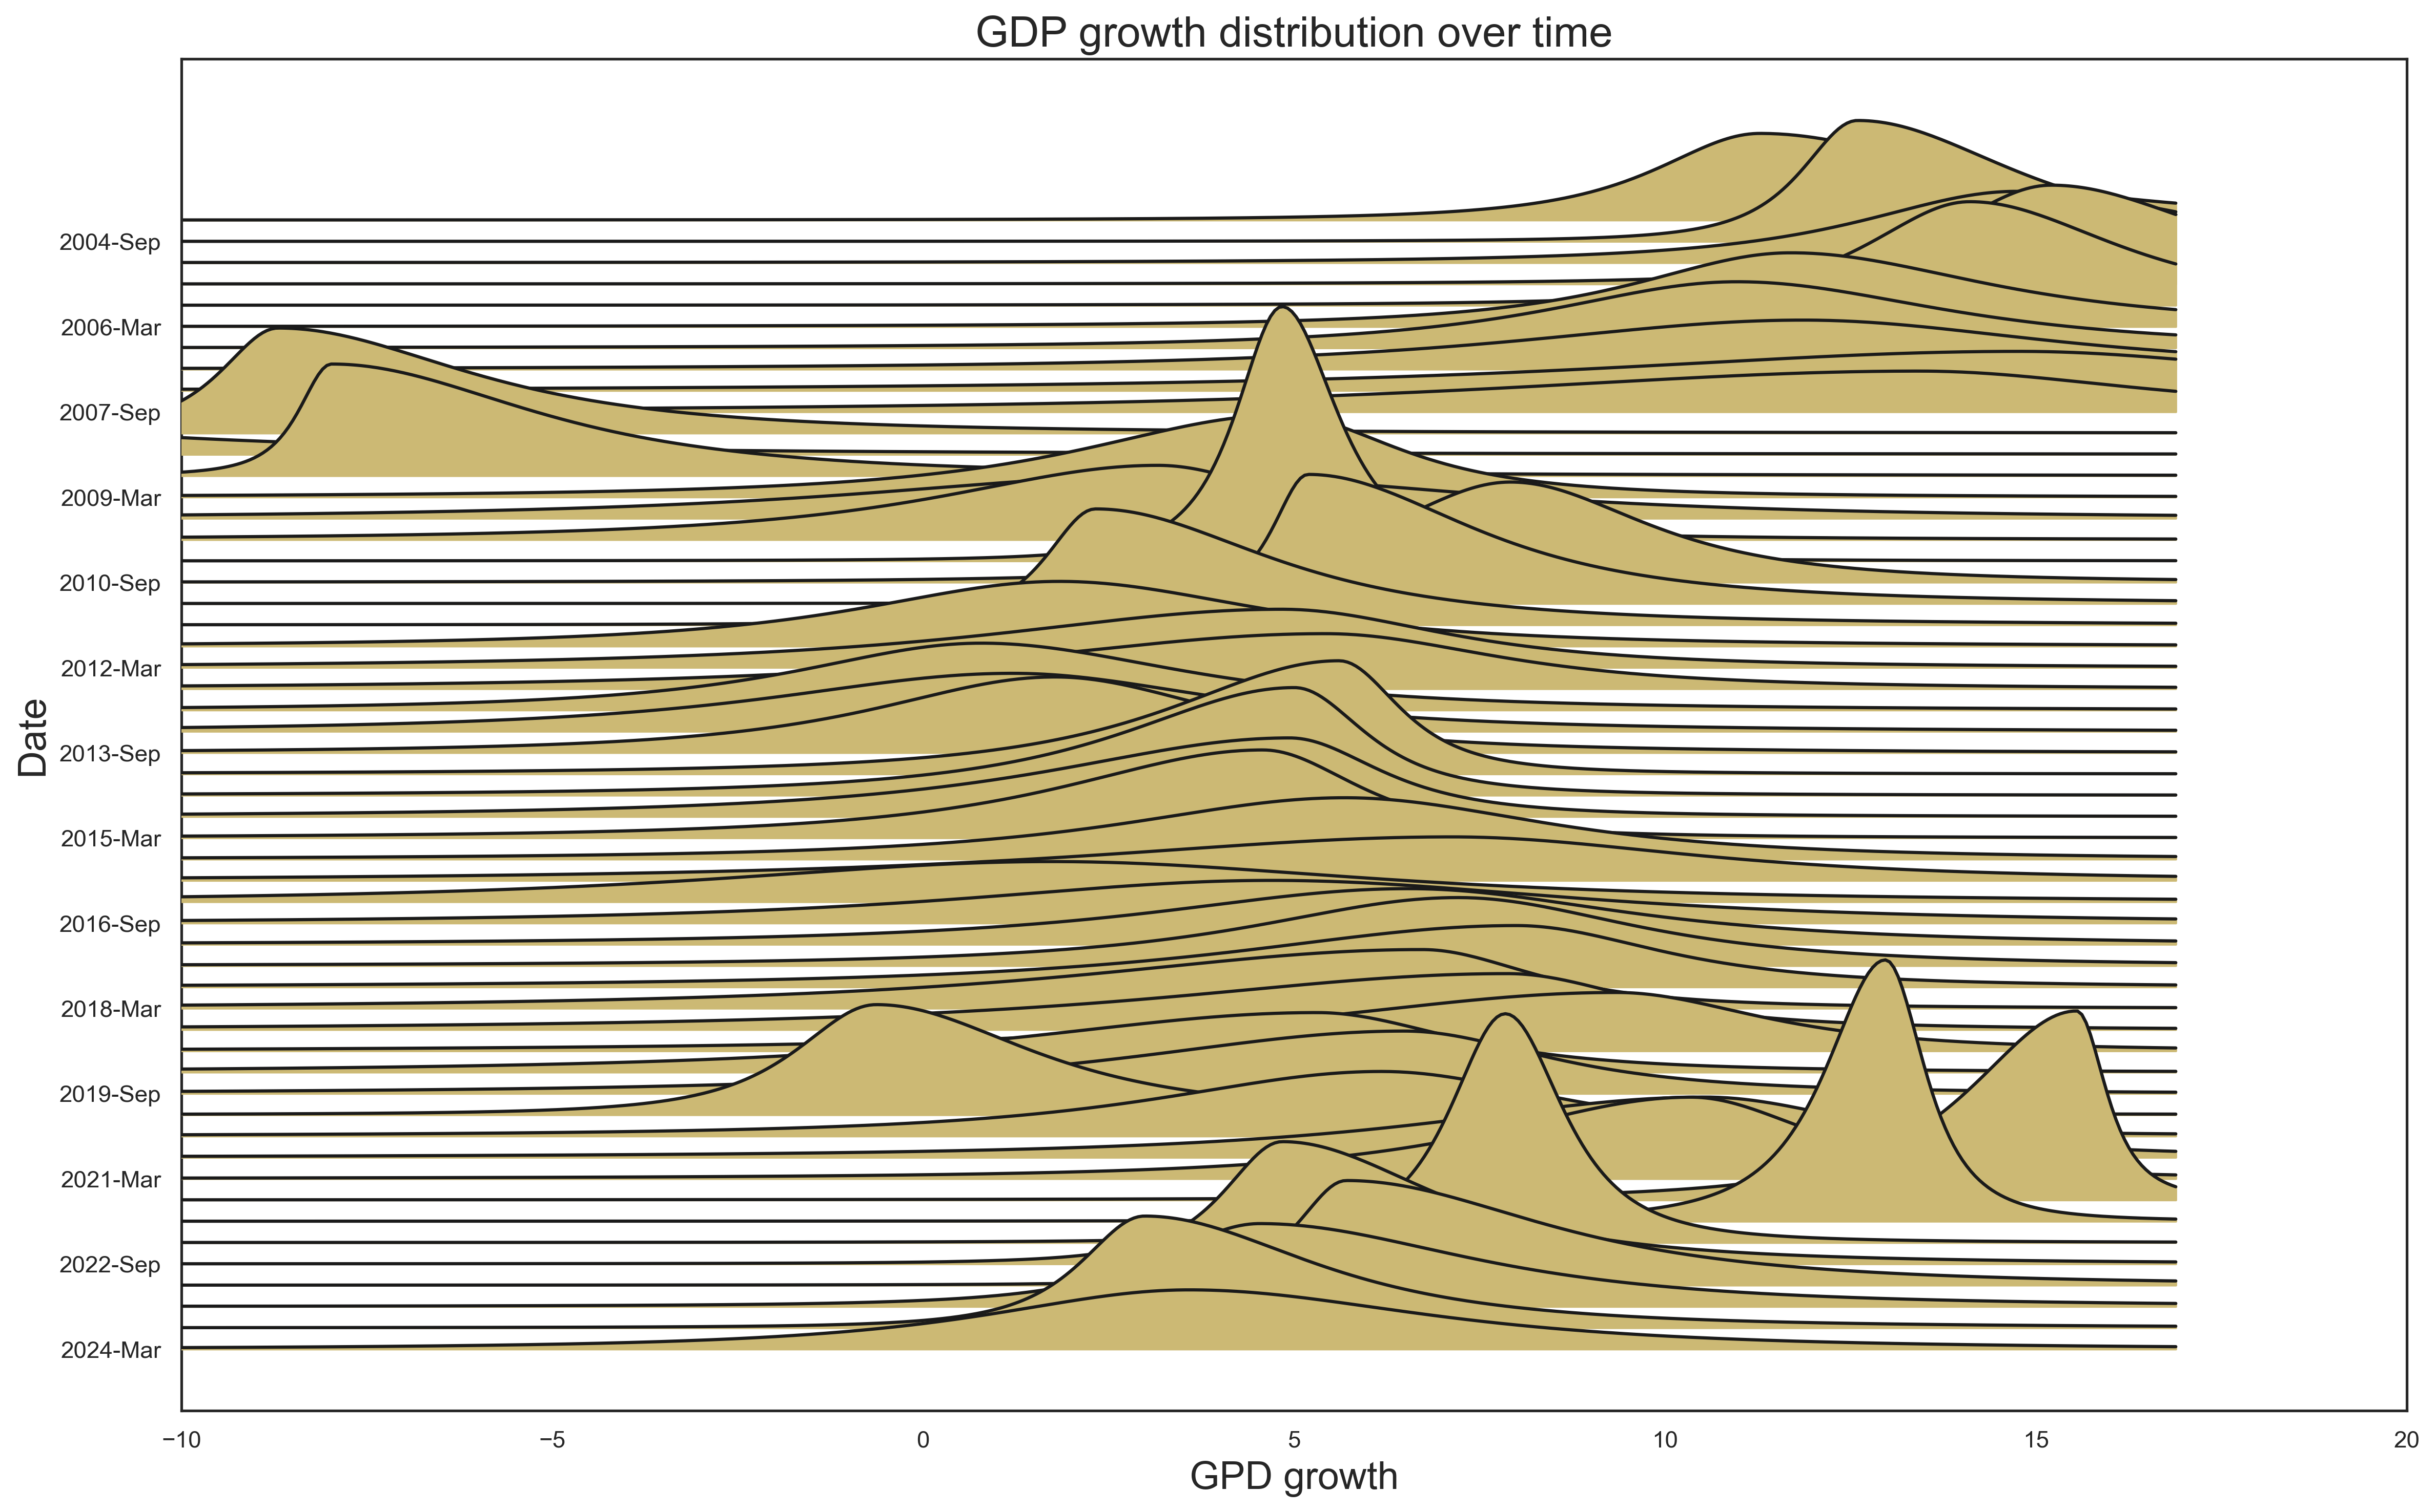
Historical quantile fit

Slide 27
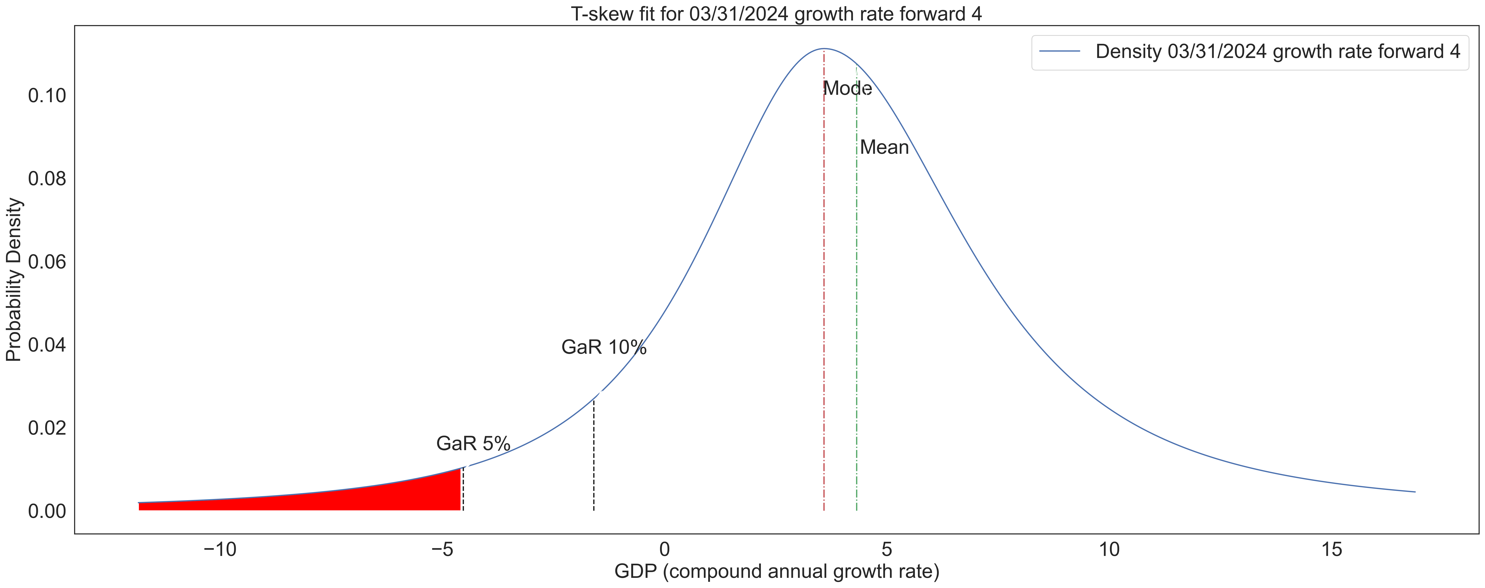
Where is Armenia today?
The distribution for 2024 shows a mode of around 4%. The GaR is -5%. Thusly, the distance to tail is 9%. We can also observe that the distribution is left skewed.

Slide 28
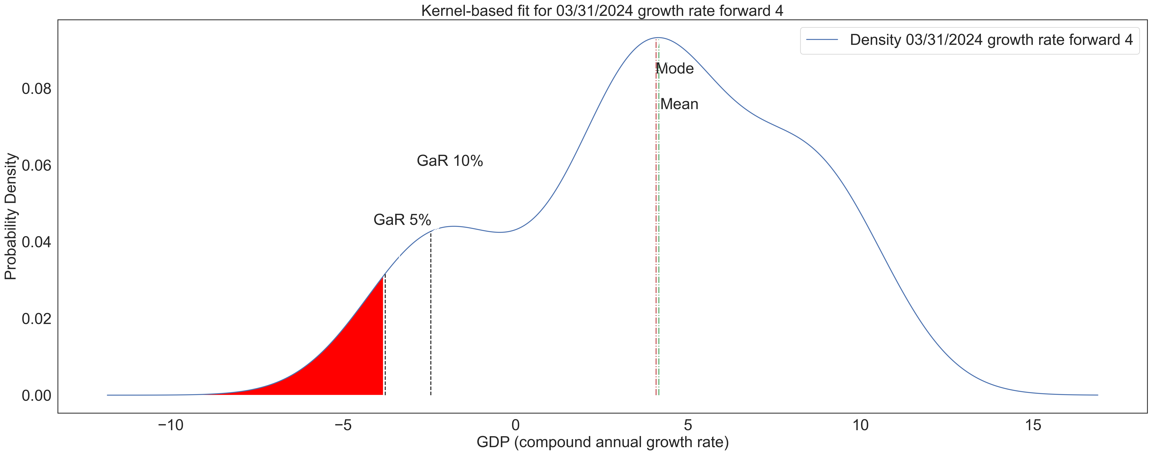
Where is Armenia today?
The kernel-based estimation allows us to more closely detect and follow the accumulation of systemic risks stemming from the financial system.

Slide 29
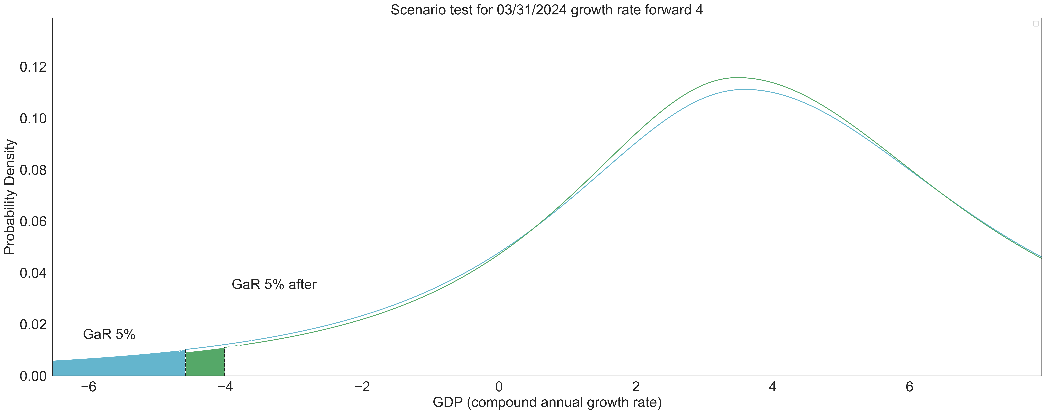
Comparing distributions
Given two arbitrary yet close distributions that offer a trade-off in the risk-reward paradigm, what should be our preference?

Slide 30
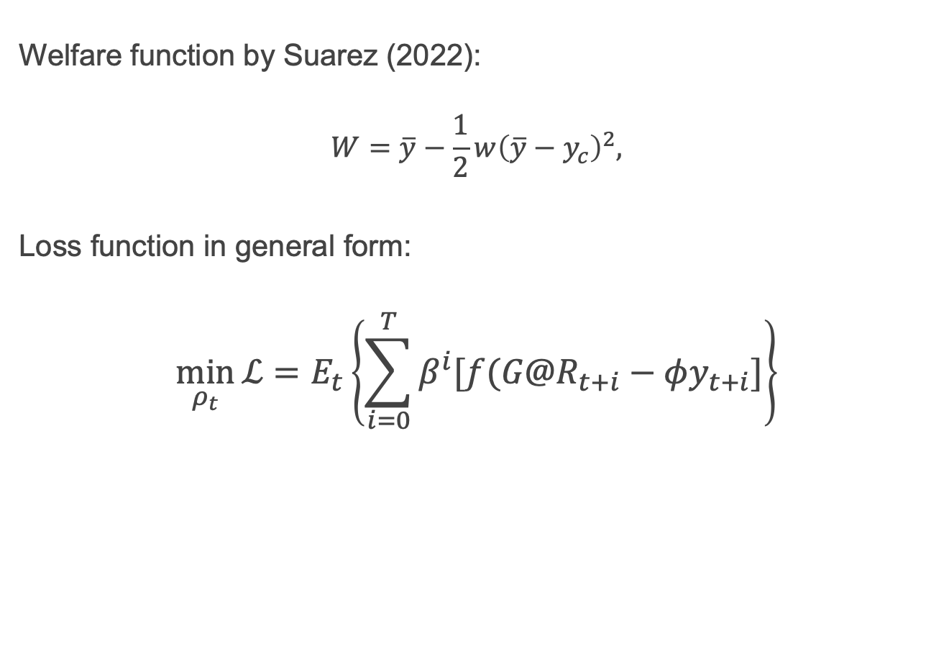
Selecting the better distribution
Welfare function by Suarez (2022):
$$W=\overline{y}−\frac{1}{2}w{\left(\overline{y}−y_{c}\right)}^{2},$$
Loss function in general form:
$$\min_{ρ_{t}}{\text{ℒ}}=E_{t}\left\{\sum_{i=0}^{T}{β^{i}[f(G@R_{t+i}−φy_{t+i}]}\right\}$$

Slide 31
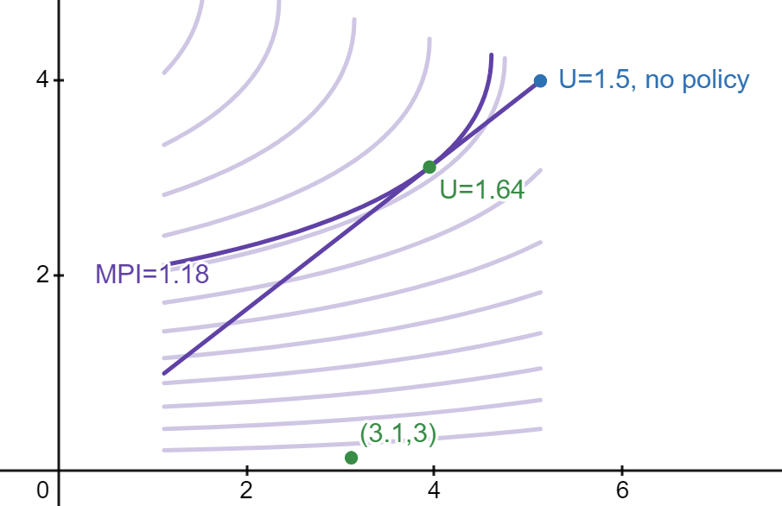
Possibility line, Suarez indifference curves and optimal policy
The optimal policy is subject to the choice of “w” term, which we can interpreted as the aversion for financial instability. This includes the policymakers appetite for risk but also the probability of shock.

Slide 32
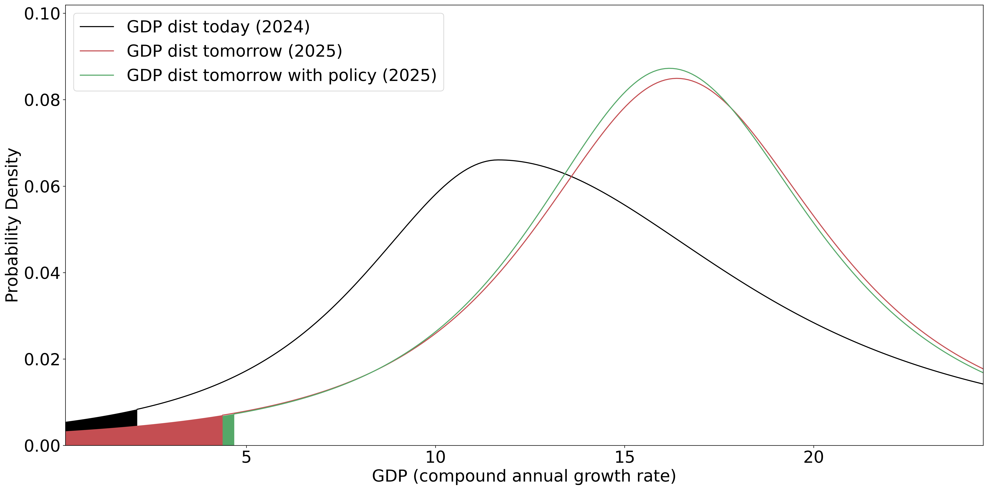
One year ahead GDP distribution forecast and optimal policy calibration

Slide 33
Limitations
Endogeneity – subject to “reverse causality,” and reduced-form regressions cannot estimate the endogenous changes
Transmission channels – econometrics methods are unable to model transmission mechanisms, specifically how the MP effects will propagate through the financial system to the real economy.
Limited data
MPI is an aggregate indicator – as a result of generalization, the specific effects of the MP instruments are lost. MPI is better suited for determining the direction of MP, but the specific tool or the magnitude of the policy action.

Slide 34
Conclusion
This project aims to quantify systemic risks and the effects of macroprudential policy on them, through the use of empirical growth-at-risk (GaR) frameworks.
It aims to augment the process of decision-making by proposing methods for designing a policy rule for macroprudential policy.
This rule shouldn't be viewed as a binding constraint, but rather as guideline that could serve as a basis for preemptive action.

Slide 35
Thank you

Slide 36
Appendix

Slide 37
Literature review
Several prominent works published in this area:
(Aikman, et al., 2019) applied GaR to a set of 16 advanced economies and found that credit booms and house price overvaluation episodes preceding crisis episodes are expected to significantly deteriorate GaR measure (which is lowest 5th or 10th percentile of GDP growth distribution) in the medium term.
(Prasad, et al., 2019) describe the results of use of GaR by IMF in Peru, Portugal and Singapore, and also present a standardized and easy-to-use Excel based tool for GaR estimation.
ESRB (ESRB, 2021) acknowledges 3 main approaches for measuring the so called “macroprudential stance”, which is essentially the measure of direction of macroprudential policy based on difference between risk accumulation level and resilence: 1. GaR approach, 2. semi-structural models and 3. indicator-based approach. Authors view the GaR (technically, the distance between lower percentile and median) as a measure of systemic risk in the system and examine the impacts of systemic risk and stress parameters on it.

Slide 38
Literature review
Several prominent works published in this area:
(Galan, 2020) conducts analysis based on a panel of 24 advanced and 12 emerging economies and finds, that effects of macroprudential policy can have differentiated impact on GDP mean growth and GDP tail based on number of dimensions (the phase of financial cycle, the direction of macroprudential policy and the type of instrument etc.). His findings confirm, that macroprudential policy effects have more medium-term impact when used in the expansionary phase of the cycle, while their use in downturns have more immediate and smaller effect.
(Suarez, 2022) offers a simple, yet very effective way for macroprudential policy decision rule by designing a welfare function, that connects future expected GDP growth with its and a parameter gauging the risk appetite of a policymaker. With his basic theoretical framework he suggests, that policymakers should not target the decrease of the tail of GDP distribution, but the distance between median and tail.

